Slide 1

KSTR: Keyword-aware Skyline Travel Route Recommendation
Student: Kae-Jer Cho
Advisor: Wen-Chih Peng

Slide 2
Outline
Introduction
Problem Definition
Related Work
Challenge Issue
Framework
Experiment
Conclusion

Slide 3

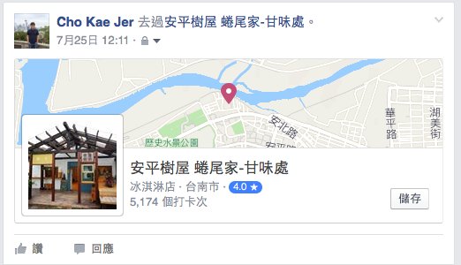



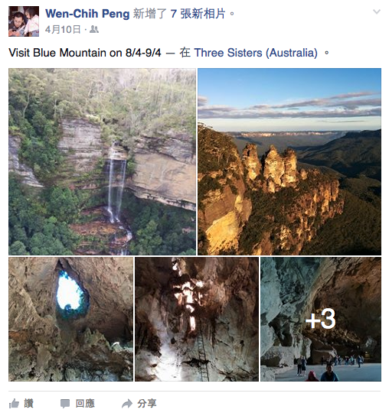
Introduction

Slide 4
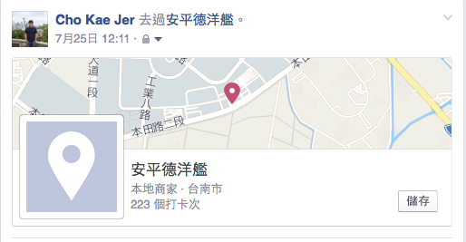
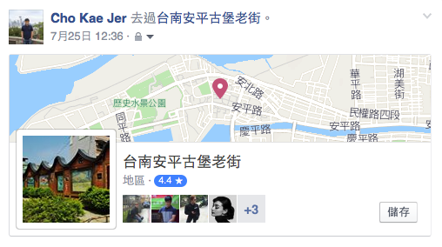
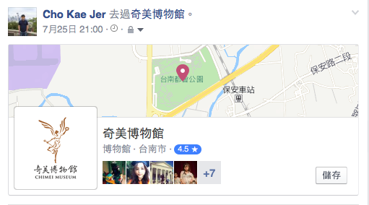
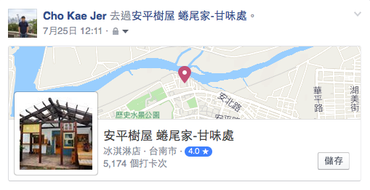
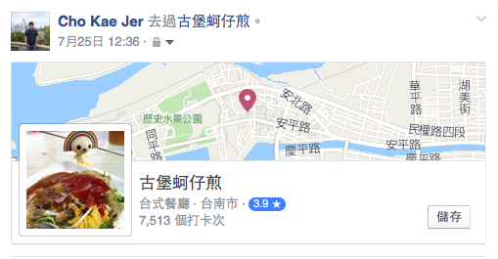
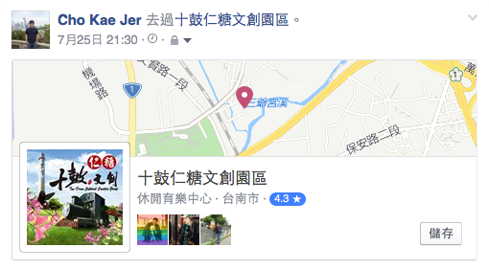
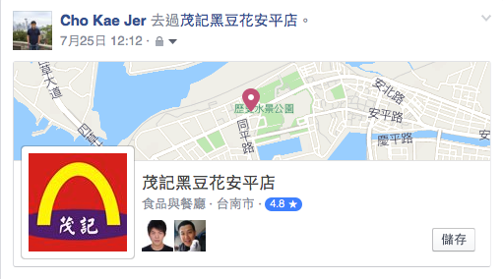
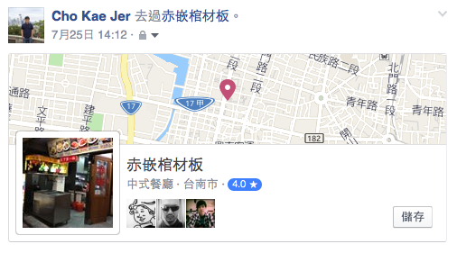
Travel route

Slide 5

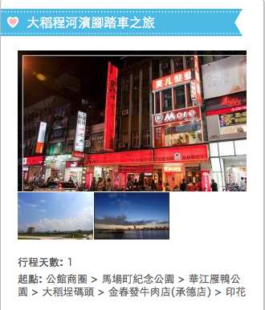
Motivation
Planning a trip
To visit a place that is attractive (Where)
To visit a place in proper time (When)
To visit a place where friends have visited (Who)
Travel routes with user preference

Slide 6
Keyword-aware Skyline Travel Route Recommendation
LBSN Dataset
Geographical check-ins
Friend relationships
Input: Visit region, Keywords
Output: Skyline travel routes with user preference by keywords
Notes:
加一個example
----- 會議記錄 (15/8/28 14:11) -----
various -> skyline

Slide 7
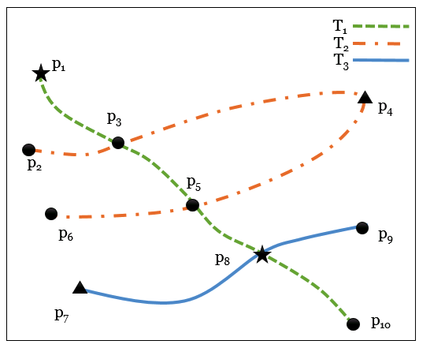
Example
Tid | Uid | Pid | Category | time | POI feature score
T2 | u2 | P3 | Bar | 12:30 | (0.25, 0.2)
T2 | u2 | P4 | Sunset | 17:00 | (0.05, 0.2)
T2 | u2 | P5 | Bar | 19:00 | (0.2, 0.8)
T2 | u2 | P6 | Bar | 19:30 | (0.25, 0.8)
T3 | u3 | P7 | Sunset | 18:30 | (0.4, 0.8)
T3 | u3 | P8 | Opera House | 19:30 | (0.04, 0.3)
T3 | u3 | P9 | Bar | 20:00 | (0.1, 0.1)
Input: Sydney, keywords:[“Whisky”,“Sydney Cove”,“Sunset”]
Output:
T2, { P3(12:30), P4(17:00), P5(19:00), P6(19:30) } (0.15,0.44)
T3, { P7(18:30), P8(19:30), P9(20:00) } (0.18,0.3)
Notes:
T1是0.1,0.34

Slide 8
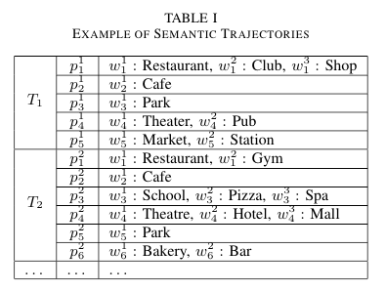
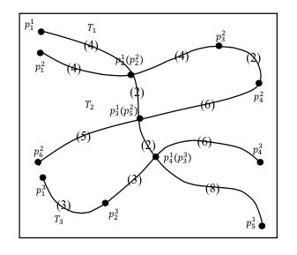
Related Work
Problem: Approximate keyword search in large scale semantic trajectory database
Input: Keywords
Output: K trajectories with the most relevant keywords and the least travel effort (travel distance)
Method: Consider keyword travel distance and travel distance
Query: ”Restaurant”
,“Theatre”
Output: T₁ From P¹₁ to P¹₄
Bolong Zheng et al. “Approximate Keyword Search in Semantic Trajectory Database” , IEEE International Conference on Data Engineering (ICDE 2015)
Notes:
近年來做travel route recommendation的work有不少，但是跟我們類似的有使用 keyword的並沒有很多，那這篇paper就跟我們的有點相關
(在一個範圍以內，input keyword，會output k條擁有最相關的keyword以及最小的旅遊effort(distance)
這篇work跟我們不同的地方在於，他們是透過input的keyword，與POI的本身的semantic keyword的相似程度來作為measurement，並且他們是只使用travel effort來當作挑選的factor，並沒有考慮到Trajectory其他的features

Slide 9
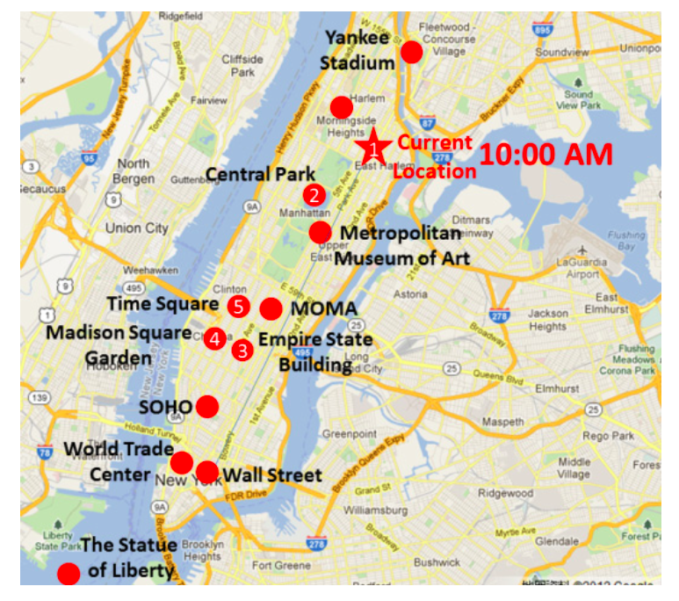
Related Work
Problem: Exploiting Large-Scale Check-in Data to Recommend Time-Sensitive Routes
Input: Start location, visiting location numbers
Output: Top-1 recommendation result
Method: Consider POI popularity, visiting time and visiting order
Query: Current location, visiting location number = 5
Output: from current location to location 5
Hsun-Ping Hsieh et al. “Exploiting Large-Scale Check-in Data to Recommend Time-Sensitive Routes”, ACM SIGKDD International Workshop on Urban Computing (UrbComp 2012)
Notes:
這篇work主要跟我們的差異是在他只有考慮了POI本身的因素，並沒有考慮使用者與這個地點的相關聯，而我們的work會透過在social network的上得到
POI與usr間的關係，而且我們不需要輸入要拜訪的POI個數

Slide 10
Related Work
 | Keyword | POI features | Time consideration | Social relation consideration | Routes generation | Recommendation
Bolong Zheng et al[1] | ∨ | ✕ | ✕ | ✕ | ✕ | Top-k
Hsun-Ping Hsieh et al[2] | ✕ | ∨ | ∨ | ✕ | ∨ | Top-1
KSTR | ∨ | ∨ | ∨ | ∨ | ∨ | Skyline
[1] Bolong Zheng et al. “Approximate Keyword Search in Semantic Trajectory Database” , IEEE International Conference on Data Engineering (ICDE 2015)
[2] Hsun-Ping Hsieh et al. “Exploiting Large-Scale Check-in Data to Recommend Time-Sensitive Routes”, ACM SIGKDD International Workshop on Urban Computing (UrbComp 2012)
Notes:
----- 會議記錄 (15/8/28 14:11) -----
看一下阿淵的投影片，看trip planning

Slide 11
Issue
User preference
How to extract users’ travel preference from input keywords
Scoring features
Which POI features should be used to make a attractive trip plan
Routes generation
Existing trajectories sometimes may not include all the query criteria
Recommendations
How to return multiple recommendation results with good quality
Notes:
在這邊我們提出在這個work裡面的一些issue，
1.透過使用者input的keyword，分成三種type，就更能瞭解使用者的旅遊喜好
2.前面有提到的3個W,第一個是哪邊是熱門的景點，第二個是在適當時間拜訪的景點，第三個是哪些是對我有影響力的人去過的景點
3.在傳統使用上會使用top-1或者是top-k的結果，那不方便的地方是該如何決定適當的k以及這樣的方式挑選出來的結果會不會很相似？
所以我們使用skyline search，因為透過skyline search我們可以挑出在每個維度都具有代表性的結果，並且我們也不需要去調整在傳統的算分上權重的問題

Slide 12
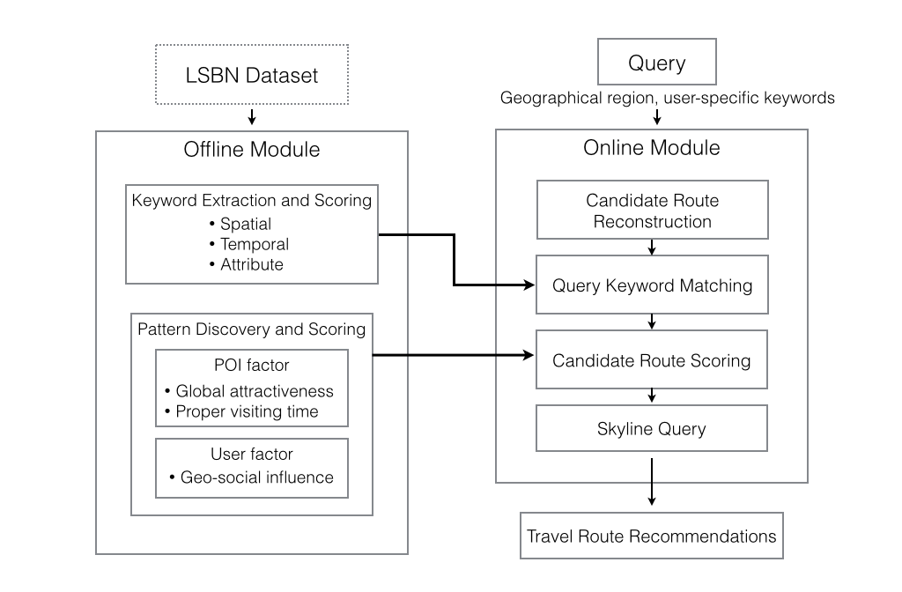
KSTR Framework
Notes:
我們提出的KSTR framework裡面，我們可以從query這邊來看，在使用者輸入要拜訪的區域以及keyword之後，我們的online

Slide 13
KSTR Framework

Slide 14
Offline Module – Keyword Extraction
 | Description | Score | Example
Geo-specific keywords (GS(K)) | Specific to a certain location | Location distributions of keywords | “Taipei 101”
Temporal keywords (TS(K)) | Specific to a certain time interval | Time distributions of keywords | “Sunset”
Attribute keywords(AT(K)) | Keywords frequently associated with a POI (TF), while not with so many other POIs (IDF) | Keyword TF-IDF: check-in frequency, user frequency, POI frequency | “Pasta”
Co-work with Prof. Seung-won Hwang (Yonsei University) and Jin-young Yeo (Pohang University of Science and Technology)
Notes:
Geo:概念是指說有某個keyword是代表某一個特定的地點，先透過geocode判斷是否這個keyword真實存在location 座標，然後透過他的地點的分布情況來計算分數
Temp:概念是說某個keyword是代表某一段特定時間，透過這個keyword出現的時間分佈來算分
Attribute:只某個keyword是不是就代表著某個POI，用TFIDF的概念，是希望找到一個keyword他常常出現在某一個POI，而不會常常出現在其他的POI，在同一個POI裡面，如果有越多相同的tag，那這個tag越能夠有機會能當作這個poi的attribute keyword
但是如果相同的user，在同一個POI，有很多的次打卡，也都有相同的tag，那可能會讓pf over estimated
所以uf是在這個POI打卡這個tag的人數
rf(L,w)是在所有的POI中，有包含w這個tag的POI個數
帶過就好
----- 會議記錄 (15/8/21 14:00) -----
不要係講，

Slide 15
KSTR Framework

Slide 16
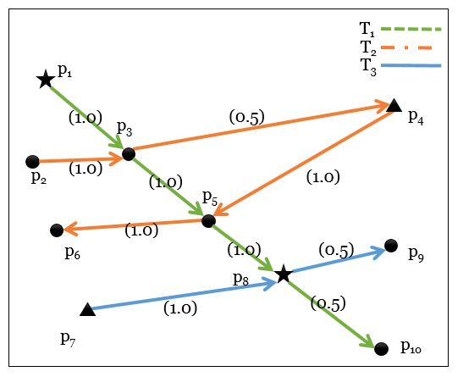
Offline Module – POI factor
Where: Attractiveness of POIs
The attractiveness of a trajectory can be inferred by a sequence of POIs and the concept of random walks
L.-Y. Wei et al, “Exploring pattern-aware travel routes for trajectory search,” ACM Transactions on Intelligent Systems and Technology, vol. 4, no. 3, pp. 48:1–48:25, 2013.
Notes:
首先，我們想要找出是比較熱門、受歡迎、有吸引力的POI，在這邊我們借用了TIST這篇paper裡面所以提出的方法，套用random walk的概念，透過馬科夫鍊計算每個POI之間的位移矩陣，可以算出每個POI的停留機率，就可以計算出每個POI的吸引力分數

Slide 17
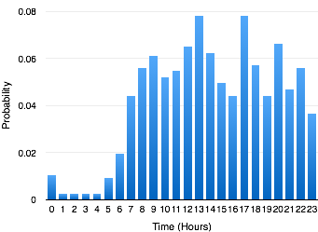
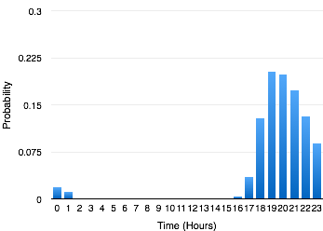
Offline Module – POI factor
When: Proper visiting time decision
The pleasure of visiting the POIs along a route is closely related to the arrival time
Taipei main station
Tainan Flowers Night Market
Notes:
接下來，我們都知道每個地點都會有適合拜訪的時間，像是我們會在晚上去逛夜市、白天的時候去海邊玩，所以我們透過每個地點在不同時間的拜訪機率，可以去知道說何時是比較適合拜訪的時間。比方說左邊這張圖是台北火車站的，在每個時間都會有人去，右邊這張圖是花園夜市，只會有晚上的時間去拜訪

Slide 18
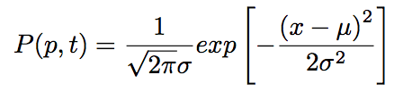
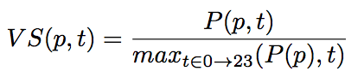
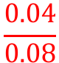
Visiting time score example
P(p,19) = 0.08
P(p,10) = 0.04
VS(p,10) =
$$\frac{0.04}{0.08}$$
Notes:
但是因為checkin的資料會有sparse的問題，比較稀疏，這樣的資料並沒有辦法得到一個很完整的分佈，所以我們把原始的checkin時間資料套入normal distribution來得到在某個POI每個時間點的拜訪機率，透過這個機率，我們定義了一個拜訪時間分數VS，我們是用在某個時間點的拜訪機率，去除以這個分佈底下最大的機率值
以這個例子來看，最高的機率是0.08，出現在大概晚上7點，所以比如說早上10點的這個POI的Visiting time score 就會是 0.04/0.08 = 0.5

Slide 19
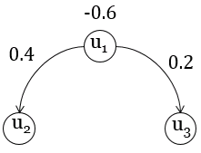
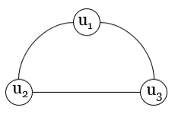
Offline Module – User factor
Who: Geographical social influence
The closer the relationship between two users, the more reliable the recommendation is
Heat diffusion-based method
Social graph
Following graph
Y.-T Wen et al. “Exploring social influence on location-based social networks”, IEEE International Conference on Data Mining (ICDM) 2015
Notes:
第三個，我們考慮的是在使用者的社群網路上，對使用者有影響力的人曾經去過的地方，我們借用了這篇ICDM2015的paper的方法，因為透過社群網路上的打卡資料的觀察，我們可以發現有些人在社群裡面是有比較大的影響力的，這邊說的影響力指的是說當這個人去過某個地方，他的社群好友也會在他之後跟著去，就像是在facebook上面如果看到彭老師之前在澳洲的時候打卡，那之後如果有機會去澳洲旅遊，那我可能會想把這個打卡的地點也排入行程中，所以透過計算這樣的影響力分數，我們可以知道哪些地點對使用者會是比較有可能會去的

Slide 20
KSTR Framework
Notes:
在online moduel的部分，我們會分別介紹keyword matching計算分數的方式、以及我們怎麼產生符合條件的candidate以及最後透過skyline將推薦的結果挑選出來

Slide 21
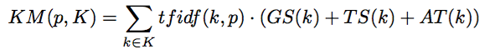
Query Keyword Matching
Keyword set K = [“night” “ximending”]
TS (“night”) = 0.9, GS(“night”)= 0.001
TS(“ximending”) = 0.5, GS(“ximending“) = 0.95
A POI “red house” in a route
tfidf(“night”)=0.3
tfidf(“ximending”)=0.8
KM(“red house”,K) = (0.3 × (0.9 + 0.001) ) + (0.8 × (0.5 + 0.95) )
Notes:
User tends to choose a travel route that contains POIs closely related to the semantic meanings.
tf is the frequency of tag k in a POI
idf is the number of POIs with the tag k.
def KM():已POI為單位來計算->一個POI p 對keyword k的 tfidf
#計算tfidf
tf:if k in POI, tf=1 else tf=0
idf:counts of POI have k (pre calculate in dict)
#計算ATAT(w) 正比於arg max_p pf x uf / rf
pf : 在POI p有多少check-in (check-in#) (pre calculate)
uf : 在POI p有多少user check-in (checkin-in distinct user #) (pre calculate)
rf : 有這個tag w的location個數
(其實定義和idf一樣，但是描述不同...)
normalized to [0,1]
score = (tf / float(idf))*AT

Slide 22
Candidate Route Reconstruction
Existing trajectories sometimes may not include all the query criteria
A DFS-based algorithm to construct new trajectories.
P1
P2
P3
New Trajectory
Trajectory 1
9:00
10:00
12:00
P1
P3
P4
Trajectory 2
10:00
13:00
15:00
Notes:
在這兩個trajectory裡面 重複出現的是P3,並且我們發現在Trajectory 2裡面，P4是接著在P3的後面，那我們確認一下拜訪時間是否合理，在Trajectory1裡面，是在12點拜訪了P3，在Trajectory2裡面拜訪P4是在下午3點，所以在時間點上並符合先後順序的，因此我們可以把P4接上原本的P3後面，那這樣就產生一條新的trajectory了！

Slide 23
Generation example
P1
P2
P3
P4
T1
9:00
10:00
11:00
12:00
P1
P3
P6
T2
9:30
10:00
10:30
P1
P4
P6
T3
10:00
12:30
14:30
Notes:
Algorithm example
P1 P2 P3 P4
P1 P3 P6
P1 P4 P6
P1 P2, P1 P3,P1 P4
P2 P3
P3 P4,P3 P6
P4 P6
->P1 P2 P3 P4 P6
->P1 P2 P3 P6
->P1 P3 P4 P6
->P1 P4 P6
->P2 P3 P4 P6
->P2P3P6

Slide 24
Generation example
P1
P2
P3
P4
P1
P2
P2
P3
P3
P4
P4
P6
9:00
10:00
10:00
11:00
11:00
12:00
12:30
14:30
P1
P3
P3
P6
9:30
11:30
10:00
10:30
P1
P4
10:00
12:30

Slide 25
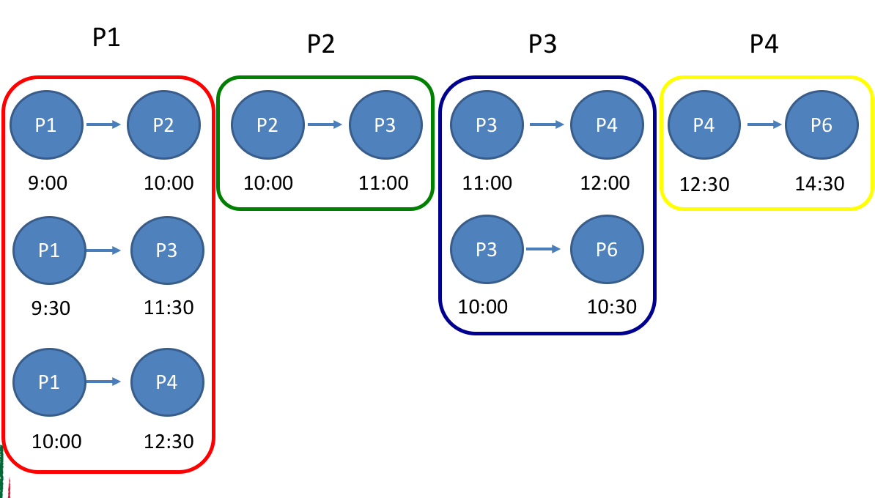
Generation example
P1
P2
P2
P3
P3
P4
P4
P6
9:00
10:00
10:00
11:00
11:00
12:00
12:30
14:30
P1
P2
P3
P4
P6
9:00
10:00
11:00
12:00
14:30

Slide 26
Generation example
P1
P2
P2
P3
P3
P6
9:00
10:00
10:00
11:00
10:00
10:30
P1
P2
P3
9:00
10:00
11:00

Slide 27
Generation example
P1
P3
P3
P4
P4
P6
9:30
11:30
11:00
12:00
12:30
14:30
P1
P3
P4
P6
9:30
11:30
12:00
14:30

Slide 28
Generation example
P1
P2
P3
P4
T1
P1
P3
P6
T2
P1
P4
P6
T3
P1
P2
P3
P4
P6
T4*
P1
P2
P3
T5*
T6*
P1
P3
P4
P6

Slide 29
Greedy pruning
The large amount of reconstructed routes suffer long process time of skyline search
POIs in trajectory with higher scores in each dimension have higher probability not to be dominated
Only use the top-N% ranked POIs to construct routes
Notes:
n: the number of original routes
l: the average length of the routes.
computing the scores and searching for low-ranked routes is computationally prohibitive.
解釋多一點

Slide 30
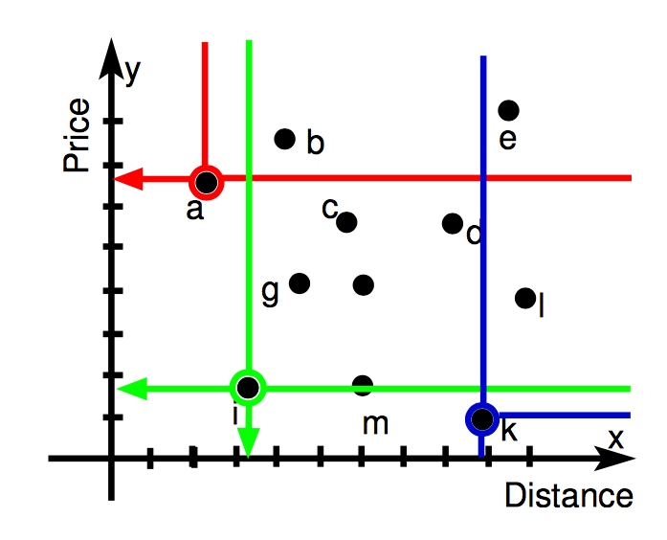
Skyline Travel Routes Search
Skyline query can return most represented trajectories without assigning a weight for each factor
Consider four dimensions:
Attractiveness score
Time score
Social influence score
Keyword matching score
Notes:
透過skyline search，我們可以找到最具有代表性的trajectories
我們可以找到所有沒有被dominate的結果，
以這個圖為例，這是一個在某個地方，每間旅館的價格與靠近海灘的距離，那我們當然是希望可以選擇到離海灘越近越好，或者是價錢越便宜越好，所以看到a旅館，雖然他在價格方面比較高，但是在距離海灘的距離上，並沒有其他點可以比他近，所以他不會被dominate，那k這個旅館，雖然距離比較遠，但是在價格上沒有其他的旅館可以比他便宜，所以k旅館也會被選出來，接下來看到i旅館，雖然他距離沙灘不是最近，價格也不是最便宜，但是並沒有其他的旅館可以在兩個維度上都dominate他，而且a,k,i這三個點並不會彼此dominate

Slide 31
Experiment
Real-world LBSN dataset
Facebook(FB)¹
Foursquare(CA)²
Efficiency
Approximate parameter
Scalability
Response time
Prediction accuracy
Edit distance
Category similarity
 | FB | CA
Duration | 08/2010- 12/2014 | 03/2010- 01/2011
Check-in | 869,317 | 483,813
Routes | 90,544 | 105,750
User | 29,512 | 4,163
POI | 225,077 | 121,142
Friendship Link | 39,513 | 32,512
^{1.}Self-crawled data from Facebook by Facebook Graph API 1.0
^{2.}Huiji Gao et al. “Modeling Temporal Effects of Human Mobile Behavior on Location-Based Social Networks”, the 22nd ACM International Conference on Information and Knowledge Management (CIKM 2013)
Notes:
----- 會議記錄 (15/8/28 14:11) -----
比較對象跟measurement,DATSET出處
settings

Slide 32
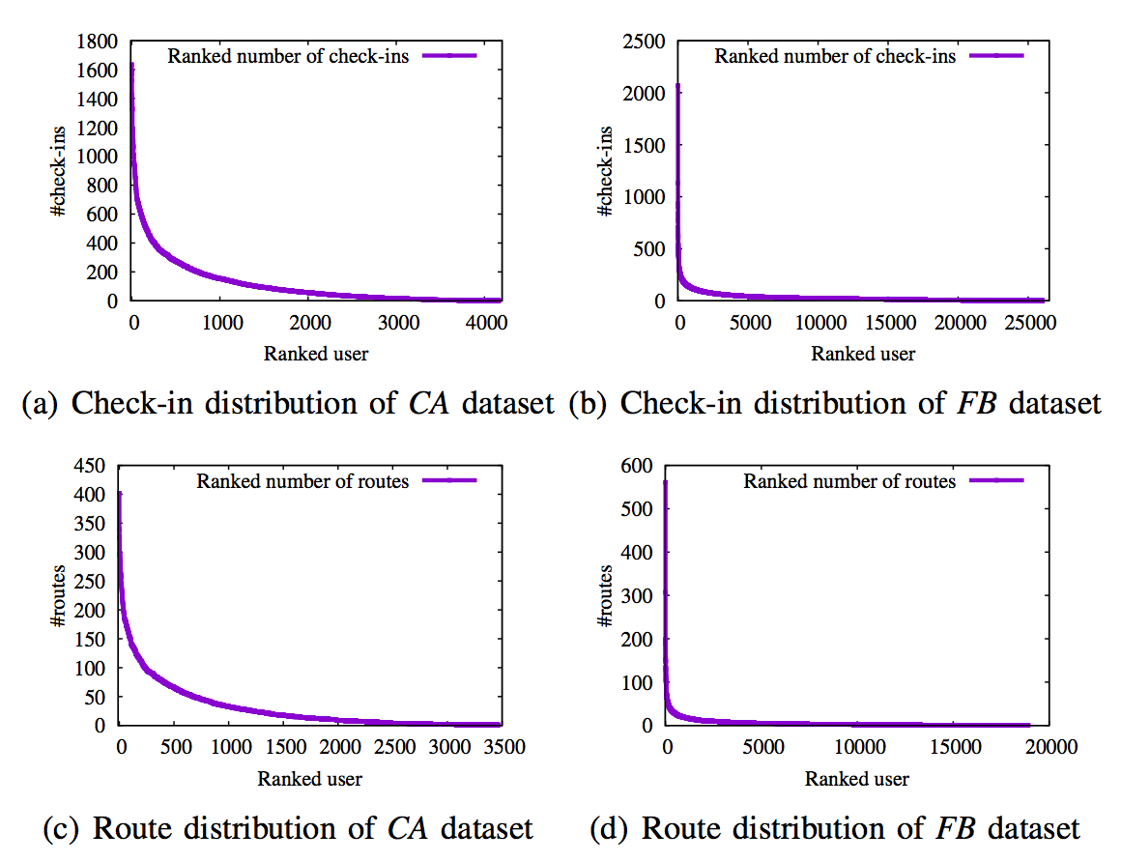
Check-in and Route distribution
Notes:
這是checkin以及route的分布圖，這邊是把每個user的checkin以及route計算count之後排序後的分布圖，
A跟b是兩個dataset的check-in的distribution,可以看得出來差不多前10%的人佔了約60%的checkins，這顯示了裡面其實大多數都不是active的usr，那因為怕受到inactive的使用者的影響，所以我們選擇了前10%的usr資料來進行實驗

Slide 33
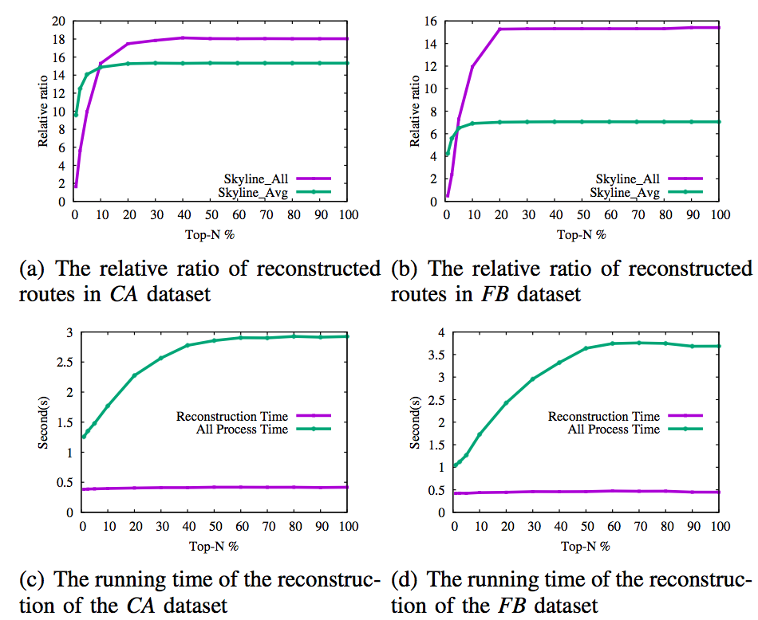
Efficiency - Tuning Approximate Parameters
Choose N=10
Notes:
在a圖跟b圖中，表示的是最後skyline選出來的是由重組所得到的路徑的比例，我們可以看到，都是在某個top n%之後，佔的比例就會固定住，在c跟d，是重組的時間跟整體process的時間，可以看到雖然重組的時間是很接近的，但是因為重組出來的量不一樣，所以process的時間會逐漸地增加，所以我們就挑取一個適合的N=10，可以得到讓重組出來的會被skyline挑出來的量比較多，而且process的時間不會花得太久，我們隨機挑選了1000組的query來做這個實驗

Slide 34
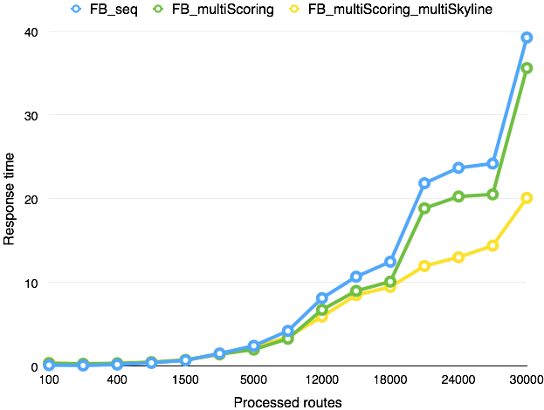
Efficiency – Scalability
Notes:
這個實驗是我們選擇透過region query回來的routes的數量來進行routes的reconstruction還有算分這些完整process 的response 時間
route的數量從100 200 400 到 1500 5000 10000 一直到 30000…測試response time的速度
因為在算分以及skyline search的部分每個route的計算是沒有相依性的，所以我們嘗試在這兩個部分進行multiprocess的處理來看看是否可以讓運算速度加快，
藍色的線代表是使用sequential的single process，綠色的線是使用8個process來進行multi process
我們可以看到在route的數量超過1萬之後，multiprocess的處理速度會逐漸的比sequential的速度快，甚至到3萬的時候，會將近只有一半的時間

Slide 35
Efficiency - Response time
Three main sub-procedures:
(i) generate candidate routes (Reconstruct)
(ii) compute the score of original and reconstructed routes (Original_scoring + Reconstruct_scoring)
(iii) Skyline search (Skyline)
FB: 43,761 testing queries
CA: 44,870 testing queries
Notes:
Response time 重算

Slide 36
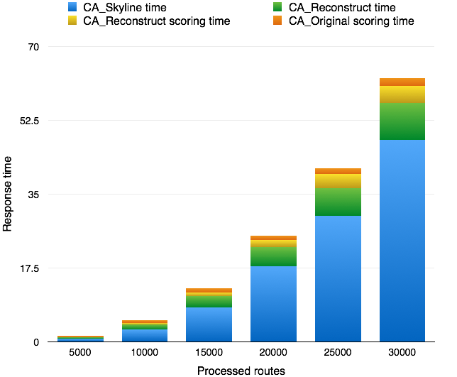
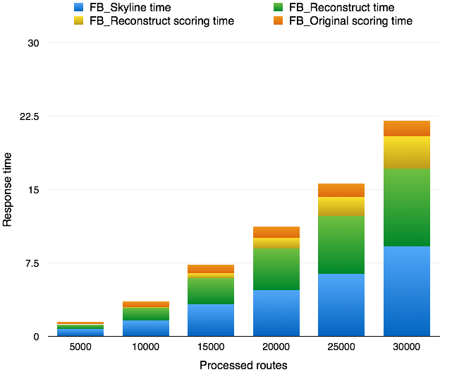
Efficiency - Response time
1%
1%
1%
2%
3%
4%
9%
6%
18%
30%
71%
50%
CA
FB

Slide 37
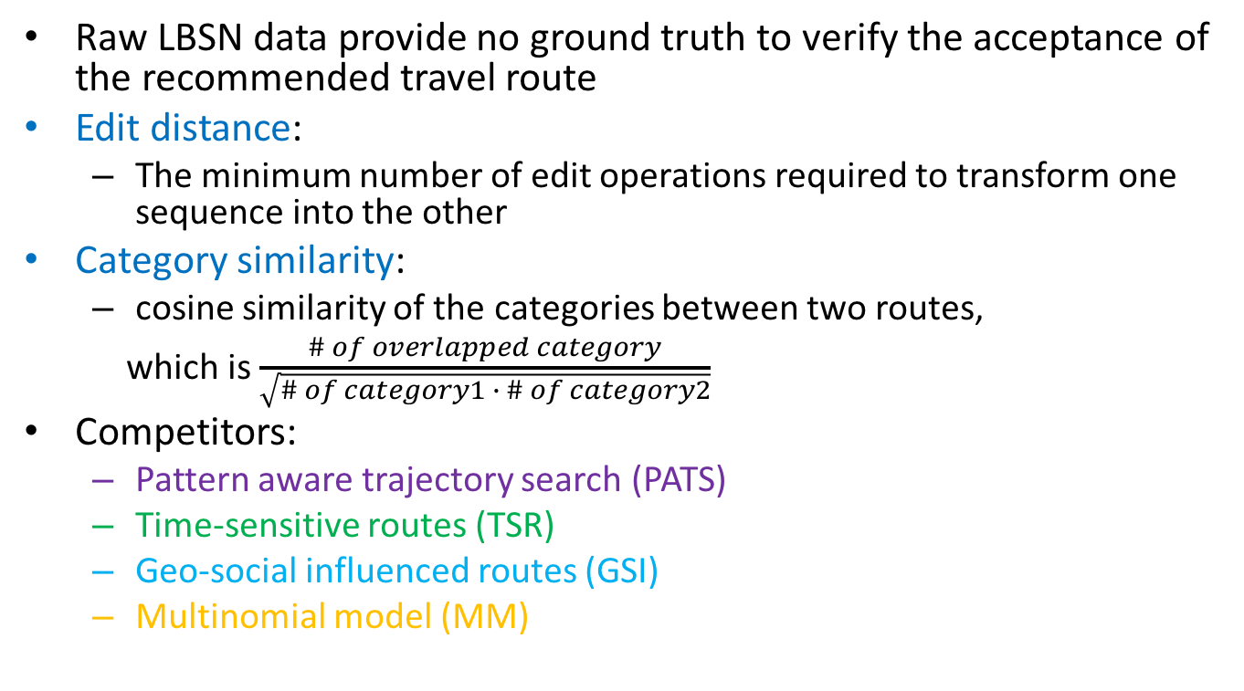
Evaluation of route prediction accuracy
Raw LBSN data provide no ground truth to verify the acceptance of the recommended travel route
Edit distance:
The minimum number of edit operations required to transform one sequence into the other
Category similarity:
cosine similarity of the categories between two routes,
which is $\frac{\# of overlapped category}{\sqrt{\# of category1 ∙ \# of category2}}$
Competitors:
Pattern aware trajectory search (PATS)
Time-sensitive routes (TSR)
Geo-social influenced routes (GSI)
Multinomial model (MM)
Notes:
MM :把全部分數加起來

Slide 38
Evaluation of route prediction accuracy
FB
CA
Notes:
紫色的是PATS,綠色的是time,藍色的是social influence,橘色的是三種加總,黃色的是KSTR
左邊的是edit distance,中間是category similarity,右邊是cover ratio
----- 會議記錄 (15/8/28 14:11) -----
cover ratio remove 分兩頁 (fb,ca)

Slide 39
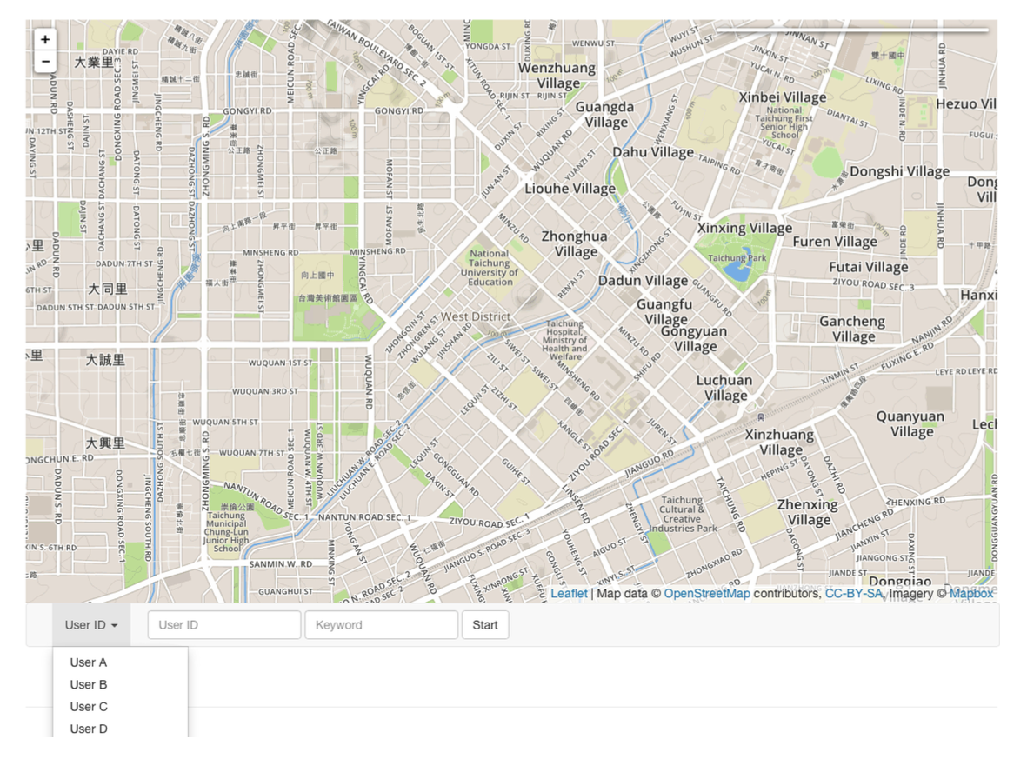
Demo

Slide 40
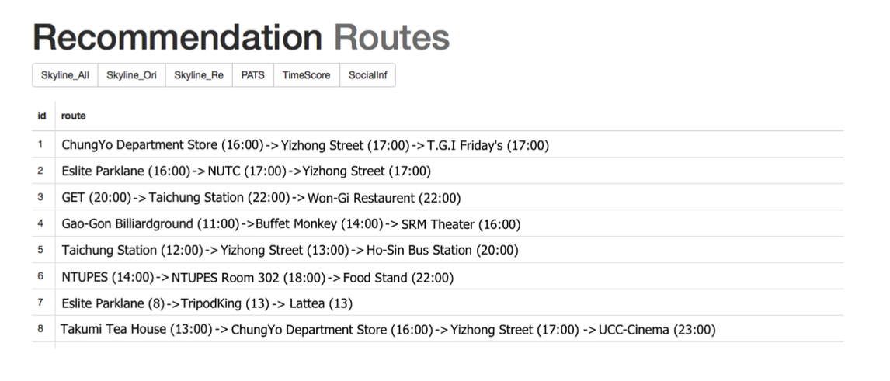
Demo

Slide 41
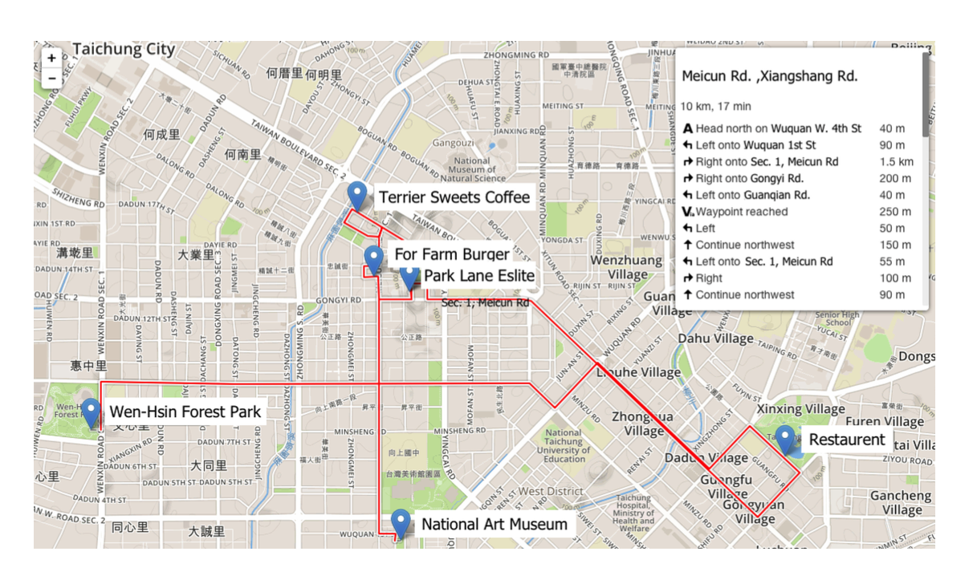
Demo

Slide 42
Conclusion
A KSTR framework to suggest travel trajectories
A keyword extraction module and match measurement of routes
Recommendation based on “Where, When, Who” features
A route reconstruction algorithm to aggregate trajectory segments
Skyline travel route recommendation instead of the traditional top-K system
A KSTR website to demonstrate the framework with application

Slide 43
Q & A
Thank you

Slide 44
Appendix
KSTR

Slide 45
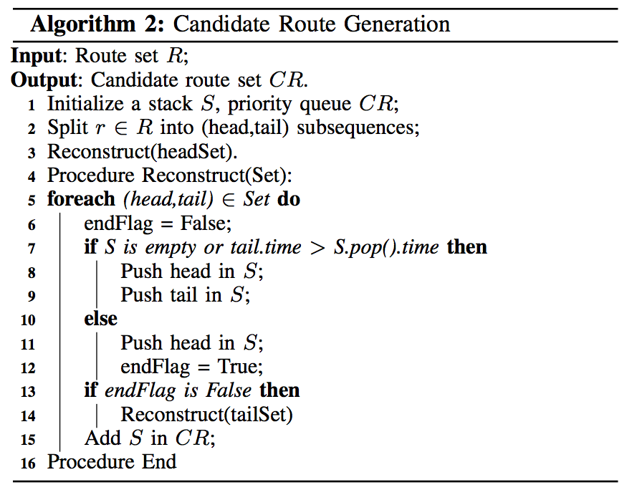
Candidate route generation algorithm

Slide 46
Keyword matching accuracy Precison@k
Precision @k | P@10 | P@20 | P@40
Geo-specific keyword | 1.000 | 1.000 | 0.975
Temporal keyword | 0.900 | 0.700 | 0.720
Attribute keyword | 1.000 | 0.850 | 0.775
Notes:
使用人工的方式將keywords判斷為geo-specfic,time-specific.和attribute
165057 photos with 958441 tags
使用2-fold cross validation，一半當作training一半當作testing
選定結果最好的來挑選threshold

Slide 47
Keyword matching Top-10 result
Top-10 Result | Keyword types
 | Geo-specific | Temporal | Attribute
1 | Longshan | Sunset | Recipe
2 | Guanghua digital plaza | Sunset | Soup
3 | Huashan creative park | Sunrise | Store
4 | NTN univ. | Dadaocheng | Oil
5 | Dadaocheng dock | Fireworks | Sale
6 | Forty-four village | Fireworks | Butter
7 | Taipei fine arts museum | Butterfly | Sauce
8 | Three gorges street | Boat | Bread
9 | Ximending | Lunch | Chicken
10 | CKS memorial hall | Night | Delivery

Slide 48
Experiment settings
x86 64 Linux server with 16 cores and 8 GB memory
PostgreSQL Database
Python 2.7
Multi-process implementation with 4 processers

Slide 49
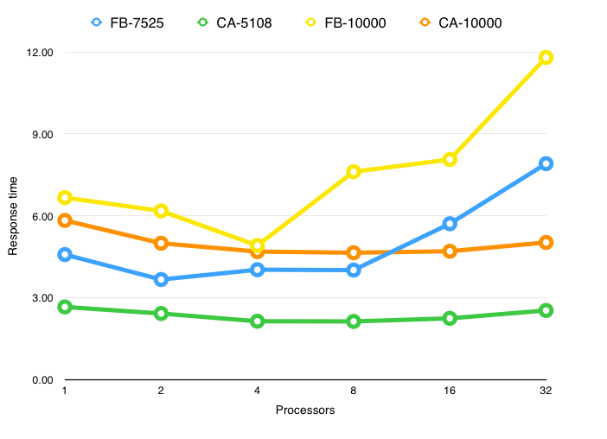
Multi-processer selection
Processer | FB-7525 | CA-5108 | FB-10000 | CA-10000
1 | 4.57 | 2.66 | 6.66 | 5.83
2 | 3.66 | 2.41 | 6.17 | 4.99
4 | 4.02 | 2.13 | 4.91 | 4.68
8 | 4.01 | 2.12 | 7.61 | 4.64
16 | 5.70 | 2.24 | 8.06 | 4.70
32 | 7.91 | 2.53 | 11.80 | 5.02

Slide 50
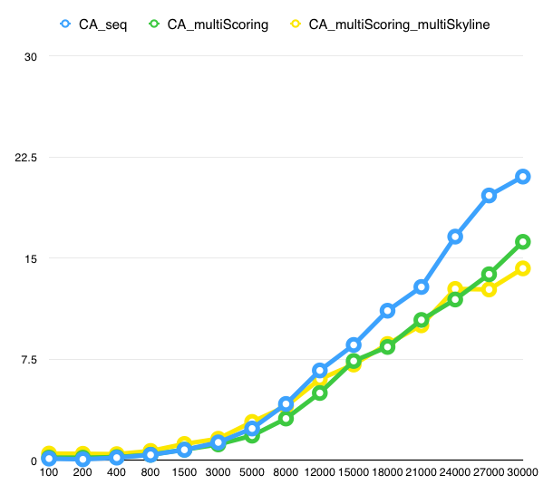
Efficiency – Scalability (CA)

Slide 51
Response time - CA
Processed Routes | Total time | Skyline time | Reconstruct time | Reconstruct scoring time | Original scoring time | Count | Count(%)
5000 | 2.56 | 0.70 | 0.33 | 0.04 | 0.29 | 31646 | 70.53%
10000 | 6.33 | 2.87 | 1.26 | 0.31 | 0.64 | 8083 | 18.01%
15000 | 14.10 | 8.06 | 2.79 | 0.87 | 0.95 | 2628 | 5.86%
20000 | 26.88 | 17.87 | 4.52 | 1.67 | 1.15 | 1124 | 2.51%
25000 | 43.27 | 29.82 | 6.65 | 3.24 | 1.49 | 430 | 0.96%
30000 | 64.90 | 47.79 | 8.79 | 4.13 | 1.76 | 296 | 0.66%
>30000 | 118.32 | 87.21 | 15.88 | 8.67 | 2.77 | 663 | 1.48%

Slide 52
Response time - FB
Processed Routes | Total time | Skyline time | Reconstruct time | Reconstruct scoring time | Original scoring time | Counts | Count(%)
5000 | 2.89 | 0.76 | 0.46 | 0.02 | 0.24 | 21717 | 49.63%
10000 | 4.99 | 1.63 | 1.27 | 0.12 | 0.53 | 13231 | 30.23%
15000 | 8.86 | 3.26 | 2.66 | 0.56 | 0.83 | 4079 | 9.32%
20000 | 12.90 | 4.72 | 4.24 | 1.11 | 1.12 | 1687 | 3.86%
25000 | 17.57 | 6.36 | 5.91 | 1.96 | 1.40 | 928 | 2.12%
30000 | 24.31 | 9.22 | 7.88 | 3.31 | 1.63 | 555 | 1.27%
>30000 | 48.88 | 21.93 | 13.57 | 7.61 | 2.52 | 1564 | 3.57%

Slide 53
Demo
http://kjcho.me/KSTR

